Slide 1
Data Structures and Algorithms
IT12112
www.hndit.com
Lecture 4

Slide 2
Linked List
www.hndit.com
To overcome the disadvantage of fixed size arrays, linked list were introduced.
A linked list consists of nodes of data which are connected with each other. Every node consist of two parts data and the link to other nodes.
The nodes are created dynamically.

Slide 3
Linked List
www.hndit.com
The Linked List is a more complex data structure than the stack and queue.
A Linked List consists of two parts, one the DATA half and the POINTER half.
The Data half contains the data that we want to store while the pointer half contains a pointer that points to the next linked list data structure.
This way we have a dynamic data structure as we can add as much data as we want within memory restrictions. And yes, pointers play a major role in Data structures...
No Pointers, No Data Structures...So Knowledge of Pointers is a basic must before continuing.

Slide 4
Linked Lists
www.hndit.com
Flexible space use
  Dynamically allocate space for each element as needed
  Include a pointer to the next item
Linked list
  Each node of the list contains
    the data item (an object pointer in our ADT)
    a pointer to the next node
Data
Next
object

Slide 5
Linked Lists
www.hndit.com
Collection structure has a pointer to the list head
  Initially NULL
Collection
Head

Slide 6
Linked Lists
www.hndit.com
Collection structure has a pointer to the list head
  Initially NULL
Add first item
  Allocate space for node
  Set its data pointer to object
  Set Next to NULL
  Set Head to point to new node
Collection
node
Head
Data
Next
object

Slide 7
Linked Lists
www.hndit.com
Add second item
  Allocate space for node
  Set its data pointer to object
  Set Next to current Head
  Set Head to point to new node
Collection
Head
node
node
Data
Next
Data
Next
object2
object

Slide 8
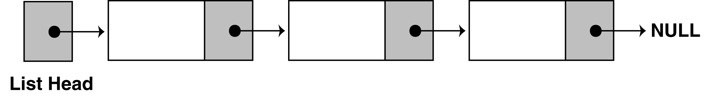
The composition of a Linked List
www.hndit.com
A linked list is called "linked" because each node in the series has a pointer that points to the next node in the list.

Slide 9
Declarations
www.hndit.com
First you must declare a data structure that will be used for the nodes. For example, the following struct could be used to create a list where each node holds a float:
struct ListNode
{
float value;
struct ListNode *next;
};

Slide 10
Declarations
www.hndit.com
The next step is to declare a pointer to serve as the list head, as shown below.
ListNode *head;
Once you have declared a node data structure and have created a NULL head pointer, you have an empty linked list.
The next step is to implement operations with the list.

Slide 11
Linked List Operations
www.hndit.com
We will use the following class declaration (on the next slide), which is stored in
FloatList.h.

Slide 12
class FloatList
{
private:
// Declare a structure for the list
struct ListNode
{
float value;
struct ListNode *next;
};
ListNode *head; // List head pointer
public:
FloatList(void) // Constructor
{ head = NULL; }
~FloatList(void); // Destructor
void appendNode(float);
void insertNode(float);
void deleteNode(float);
void displayList(void);
};
www.hndit.com

Slide 13
Appending a Node to the List
www.hndit.com
To append a node to a linked list means to add the node to the end of the list.
The pseudocode is shown below. The C++ code follows.
Create a new node.
Store data in the new node.
If there are no nodes in the list
Make the new node the first node.
Else
Traverse the List to Find the last node.
Add the new node to the end of the list.
End If.

Slide 14
void FloatList::appendNode(float num)
{
ListNode *newNode, *nodePtr;
// Allocate a new node & store num
newNode = new ListNode;
newNode->value = num;
newNode->next = NULL;
// If there are no nodes in the list
// make newNode the first node
if (!head)
head = newNode;
else // Otherwise, insert newNode at end
{
// Initialize nodePtr to head of list
nodePtr = head;
// Find the last node in the list
while (nodePtr->next!=NULL)
nodePtr = nodePtr->next;
// Insert newNode as the last node
nodePtr->next = newNode;
}
}
www.hndit.com

Slide 15
Implementation
www.hndit.com
// This program demonstrates a simple append
// operation on a linked list.
#include <iostream.h>
#include "FloatList.h”
void main(void)
{
FloatList List;
list.appendNode(2.5);
list.appendNode(7.9);
list.appendNode(12.6);
}
(This program displays no output.)

Slide 16
Stepping Through the Program
www.hndit.com
The head pointer is declared as a global variable. head is automatically initialized to 0 (NULL), which indicates that the list is empty.
The first call to appendNode passes 2.5 as the argument. In the following statements, a new node is allocated in memory, 2.5 is copied into its value member, and NULL is assigned to the node's next pointer.

Slide 17
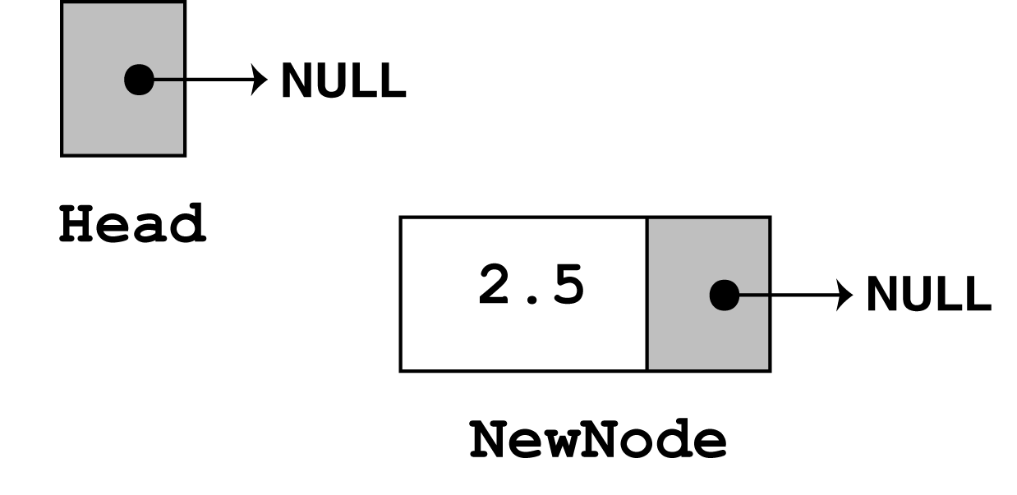
www.hndit.com
newNode = new ListNode;
newNode->value = num;
newNode->next = NULL;

Slide 18
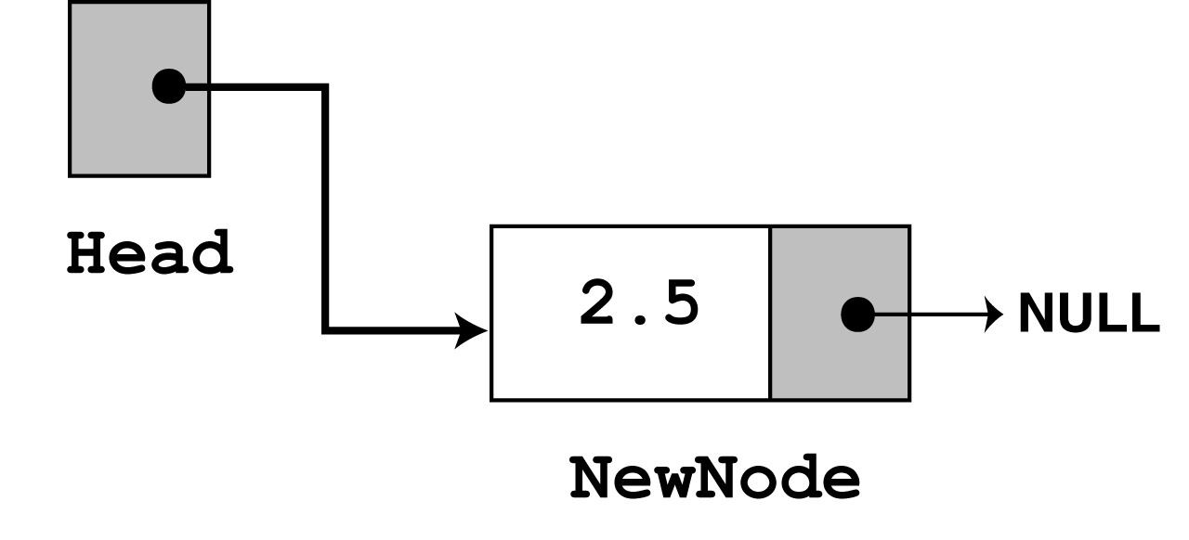
The next statement to execute is the following if statement.
if (!head)
head = newNode;
www.hndit.com
There are no more statements to execute, so control returns to function main.

Slide 19
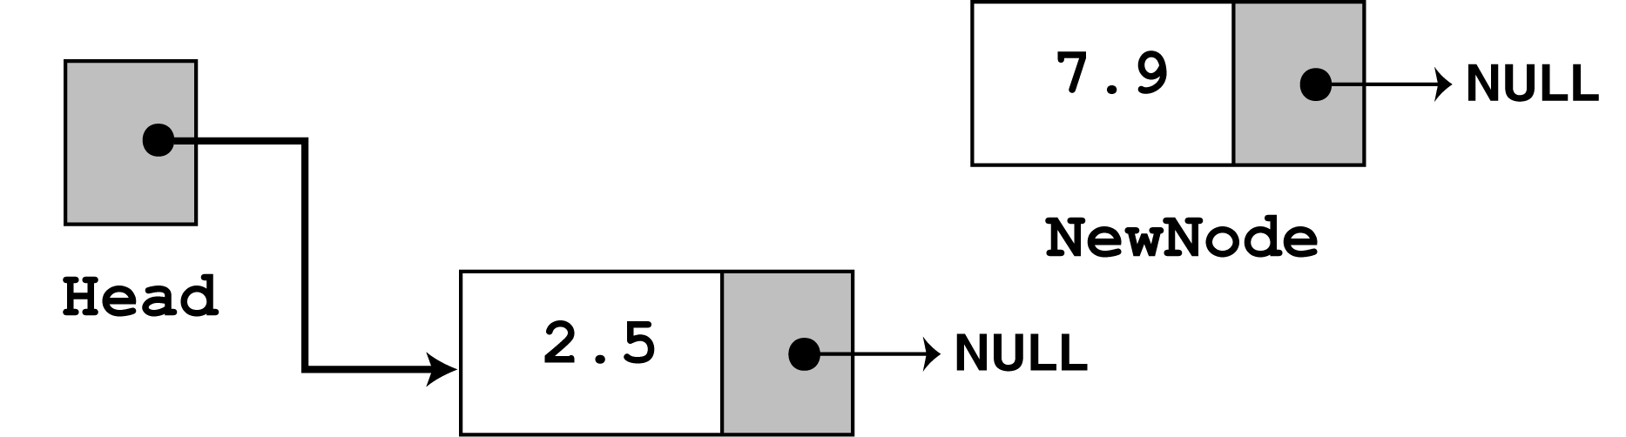
www.hndit.com
In the second call to appendNode, 7.9 is passed as the argument. Once again, the first three statements in the function create a new node, store the argument in the node's value member, and assign its next pointer to NULL.

Slide 20
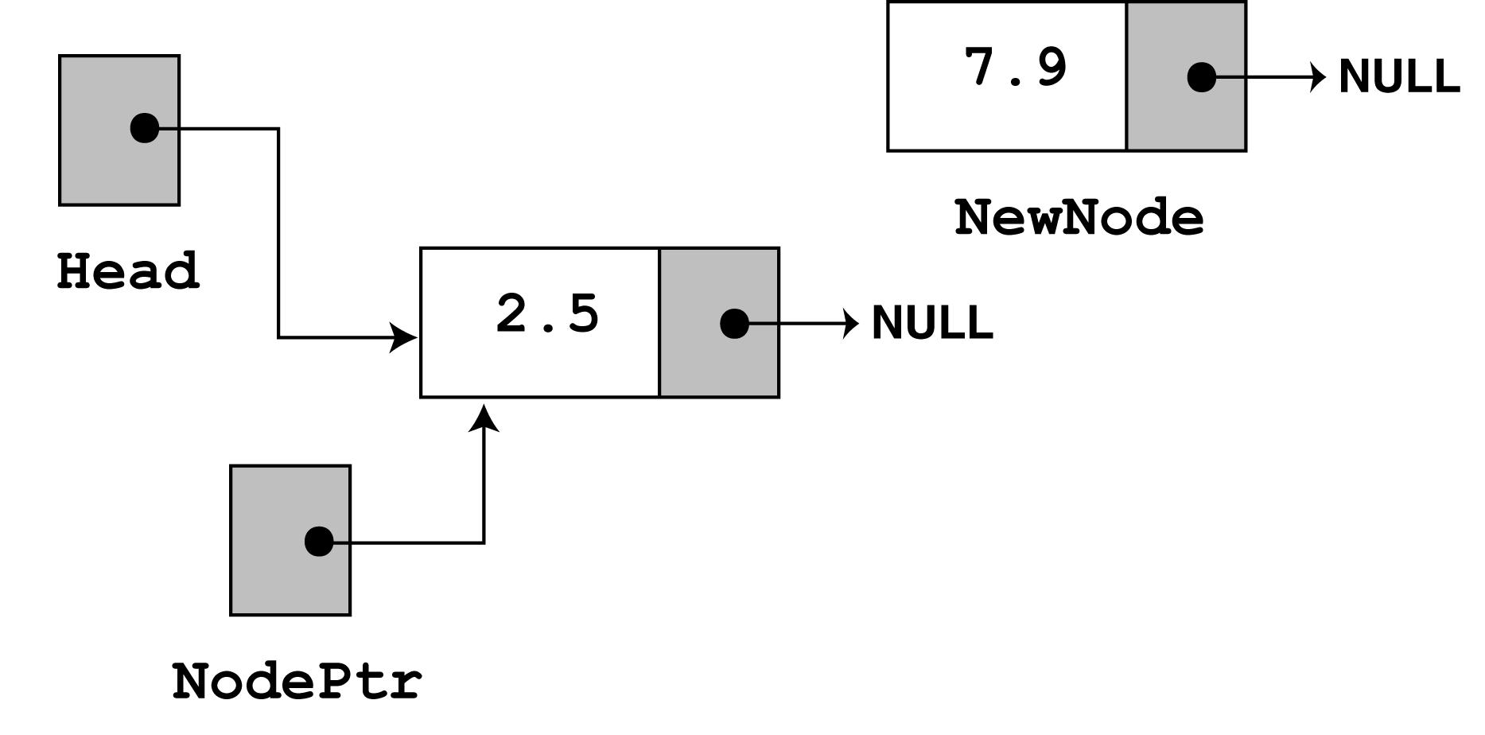
Since head no longer points to NULL, the else part of the if statement executes:
else // Otherwise, insert newNode at end
{
// Initialize nodePtr to head of list
nodePtr = head;
// Find the last node in the list
while (nodePtr->next)
nodePtr = nodePtr->next;
// Insert newNode as the last node
nodePtr->next = newNode;
}
www.hndit.com

Slide 21
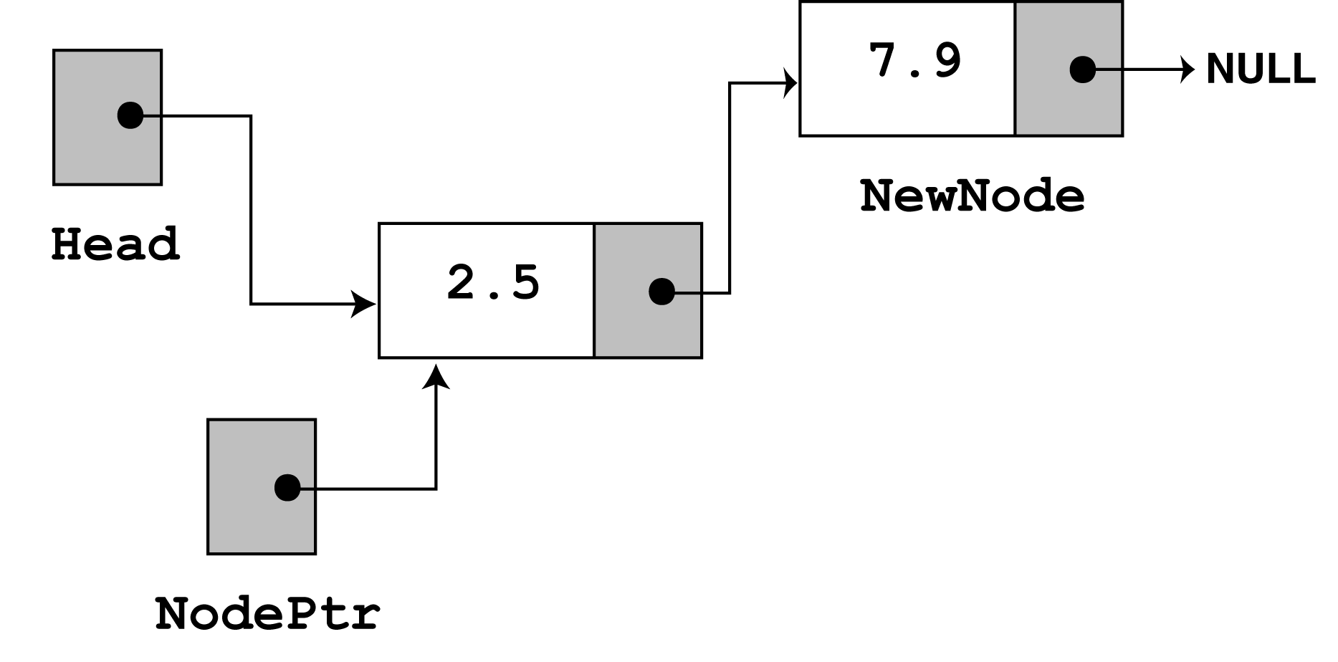
nodePtr is already at the end of the list, so the while loop immediately terminates. The last statement, nodePtr->next = newNode; causes nodePtr->next to point to the new node. This inserts newNode at the end of the list.
www.hndit.com

Slide 22
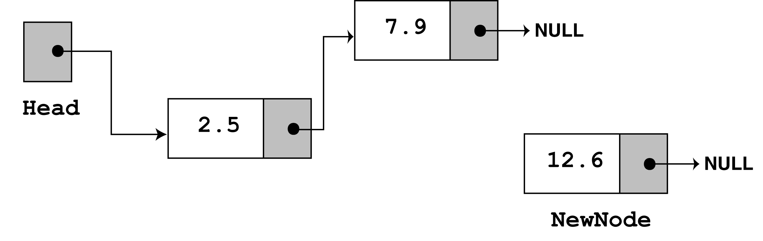
The third time appendNode is called, 12.6 is passed as the argument. Once again, the first three statements create a node with the argument stored in the value member.
www.hndit.com

Slide 23
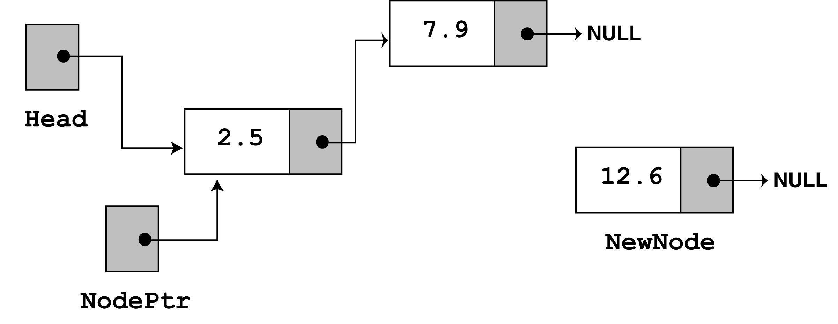
www.hndit.com
next, the else part of the if statement executes. As before, nodePtr is made to point to the same node as head.

Slide 24
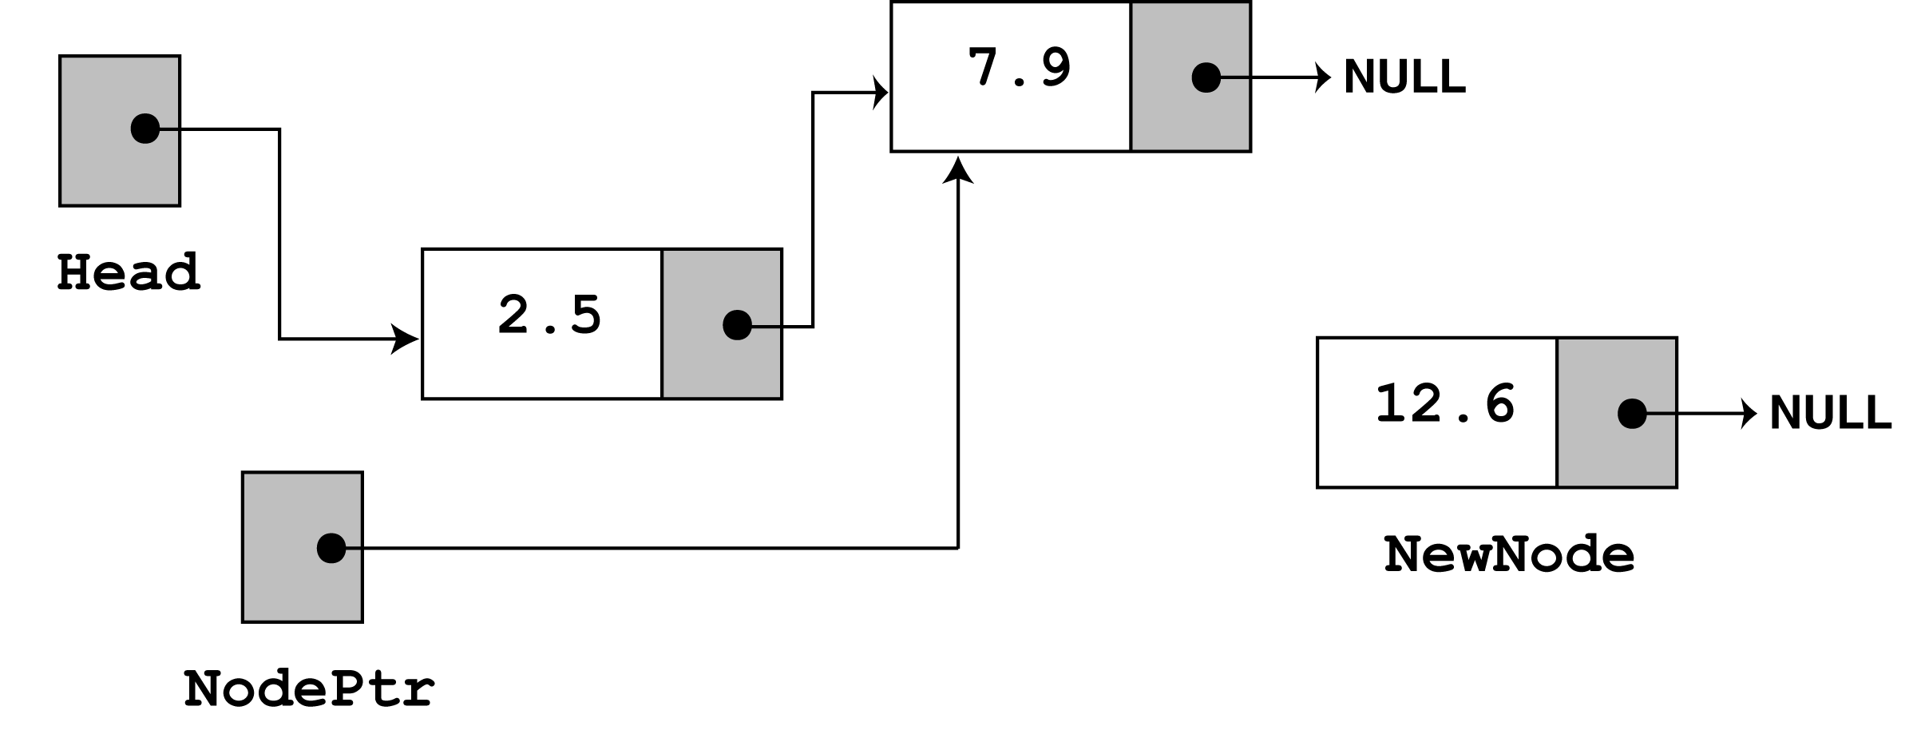
Since nodePtr->next is not NULL, the while loop will execute. After its first iteration, nodePtr will point to the second node in the list.

Slide 25
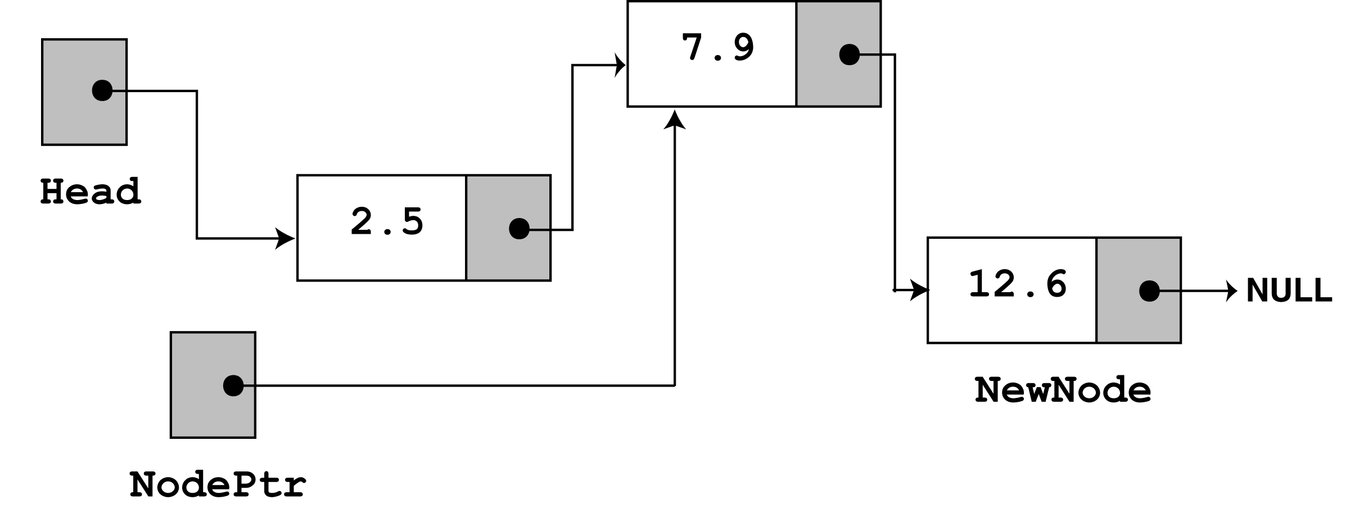
www.hndit.com
The while loop's conditional test will fail after the first iteration because nodePtr->next now points to NULL. The last statement, nodePtr->next = newNode; causes
nodePtr->next to point to the new node. This inserts newNode at the end of the list
The figure above depicts the final state of the linked list.

Slide 26
Traversing the List
www.hndit.com
The displayList member function traverses the list, displaying the value member of each node. The following pseudocode represents the algorithm. The C++ code for the member function follows on the next slide.
Assign List head to node pointer.
While node pointer is not NULL
Display the value member of the node pointed to by node pointer.
Assign node pointer to its own next member.
End While.

Slide 27
www.hndit.com
void FloatList::displayList(void)
{
ListNode *nodePtr;
nodePtr = head;
while (nodePtr)
{
cout << nodePtr->value << endl;
nodePtr = nodePtr->next;
}
}

Slide 28
Implementation
www.hndit.com
// This program calls the displayList member function.
// The funcion traverses the linked list displaying
// the value stored in each node.
#include <iostream.h>
#include "FloatList.h"
void main(void)
{
FloatList List;
list.appendNode(2.5);
list.appendNode(7.9);
list.appendNode(12.6);
list.displayList();
}

Slide 29
Output
www.hndit.com
2.5
7.9
12.6

Slide 30
Inserting a Node
www.hndit.com
Using the listNode structure again, the pseudocode on the next slide shows an algorithm for finding a new node’s proper position in the list and inserting there.
The algorithm assumes the nodes in the list are already in order.

Slide 31
www.hndit.com
Create a new node.
Store data in the new node.
If there are no nodes in the list
Make the new node the first node.
Else
Find the first node whose value is greater than or equal
the new value, or the end of the list (whichever is first).
Insert the new node before the found node, or at the end of
the list if no node was found.
End If.

Slide 32
The code for the traversal algorithm is shown below. (As before, num holds the value being inserted into the list.)
www.hndit.com
// Initialize nodePtr to head of list
nodePtr = head;
// Skip all nodes whose value member is less
// than num.
while (nodePtr != NULL && nodePtr->value < num)
{
previousNode = nodePtr;
nodePtr = nodePtr->next;
}
The entire insertNode function begins on the next slide.

Slide 33
void FloatList::insertNode(float num)
{
ListNode *newNode, *nodePtr, *previousNode;
// Allocate a new node & store Num
newNode = new ListNode;
newNode->value = num;
// If there are no nodes in the list
// make newNode the first node
if (!head)
{
head = newNode;
newNode->next = NULL;
}
else // Otherwise, insert newNode.
{
// Initialize nodePtr to head of list
nodePtr = head;
// Skip all nodes whose value member is less
// than num.
while (nodePtr != NULL && nodePtr->value < num)
{
previousNode = nodePtr;
nodePtr = nodePtr->next;
}
www.hndit.com
Continued on next slide…

Slide 34
Continued from previous slide.
www.hndit.com
// If the new node is to be the 1st in the list,
// insert it before all other nodes.
if (previousNode == NULL)
{
head = newNode;
newNode-> = nodePtr;
}
else
{
previousNode->next = newNode;
newNode->next = nodePtr;
}
}
}

Slide 35
Implementation
www.hndit.com
// This program calls the displayList member function.
// The function traverses the linked list displaying
// the value stored in each node.
#include <iostream.h>
#include "FloatList.h”
void main(void)
{
FloatList list;
// Build the list
list.appendNode(2.5);
list.appendNode(7.9);
list.appendNode(12.6);
// Insert a node in the middle
// of the list.
list.insertNode(10.5);
// Dispay the list
list.displayList();
}

Slide 36
Output
www.hndit.com
2.5
7.9
10.5
12.6

Slide 37
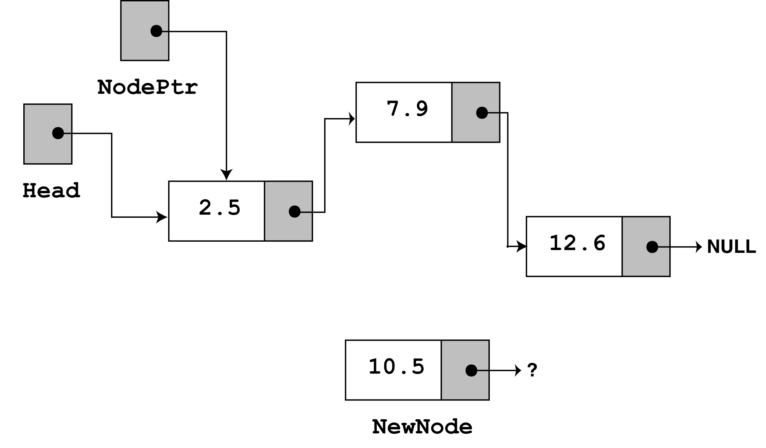
In insertNode, a new node is created and the function argument is copied to its value member. Since the list already has nodes stored in it, the else part of the if statement will execute. It begins by assigning nodePtr to head.

Slide 38
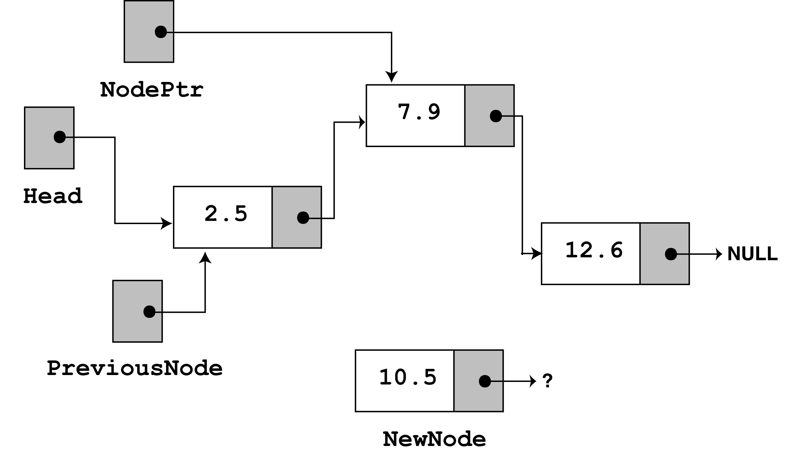
www.hndit.com
Since nodePtr is not NULL and nodePtr->value is less than num, the while loop will iterate. During the iteration, previousNode will be made to point to the node that nodePtr is pointing to. nodePtr will then be advanced to point to the next node.

Slide 39
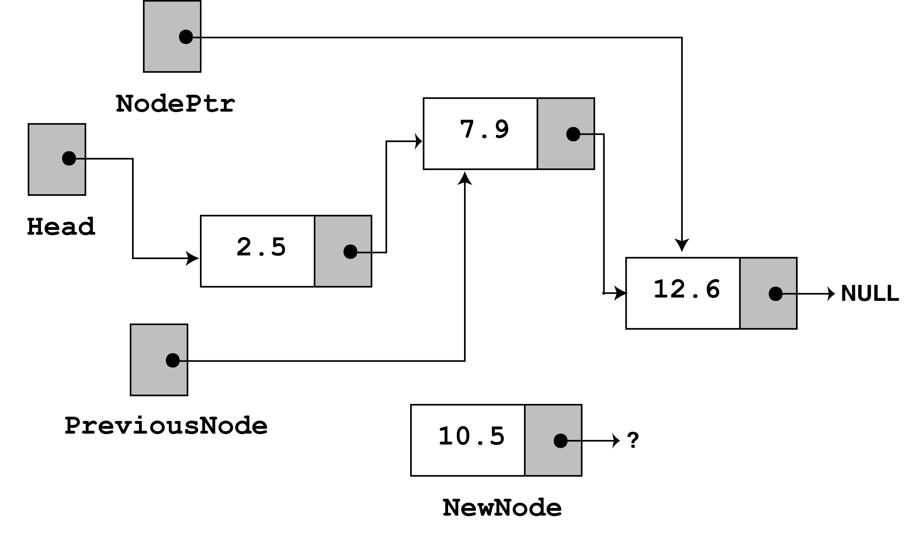
Once again, the loop performs its test. Since nodePtr is not NULL and nodePtr->value is less than num, the loop will iterate a second time. During the second iteration, both previousNode and nodePtr are advanced by one node in the list.

Slide 40
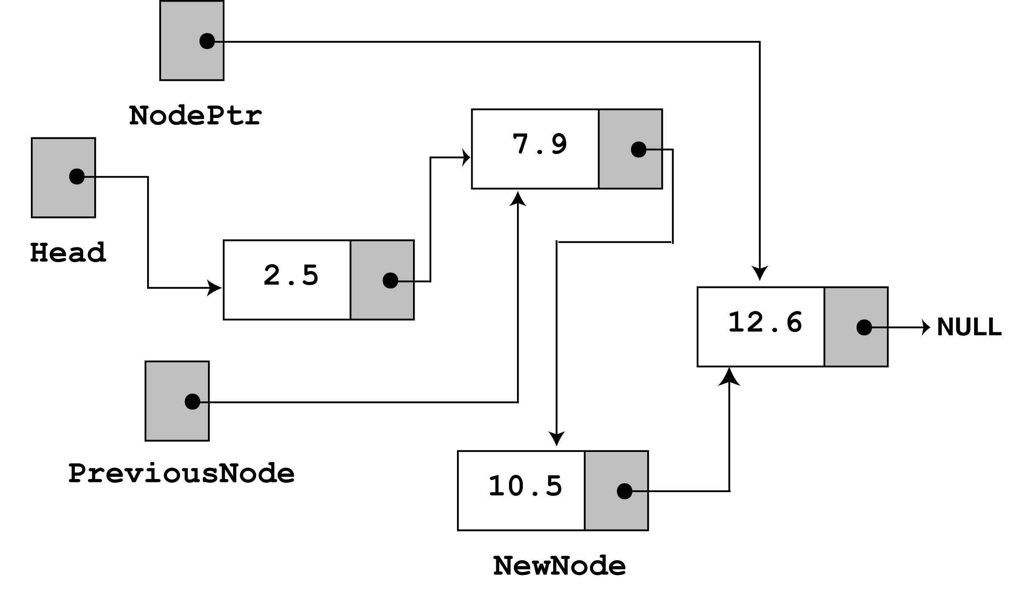
This time, the loop's test will fail because nodePtr is not less than num. The statements after the loop will execute, which cause previousNode->next to point to newNode, and newNode->next to point to nodePtr.
www.hndit.com
If you follow the links, from the head pointer to the NULL, you will see that the nodes are stored in the order of their value members.

Slide 41
Deleting a Node
www.hndit.com
Deleting a node from a linked list requires two steps:
  Remove the node from the list without breaking the links created by the next pointers
  Deleting the node from memory
The deleteNode function begins on the next slide.

Slide 42
void FloatList::deleteNode(float num)
{
ListNode *nodePtr, *previousNode;
// If the list is empty, do nothing.
if (!head)
return;
// Determine if the first node is the one.
if (head->value == num)
{
nodePtr = head->next;
delete head;
head = nodePtr;
}
www.hndit.com
Continued on next slide…

Slide 43
Continued from previous slide.
www.hndit.com
else
{
// Initialize nodePtr to head of list
nodePtr = head;
// Skip all nodes whose value member is
// not equal to num.
while (nodePtr != NULL && nodePtr->value != num)
{
previousNode = nodePtr;
nodePtr = nodePtr->next;
}
// Link the previous node to the node after
// nodePtr, then delete nodePtr.
previousNode->next = nodePtr->next;
delete nodePtr;
}
}

Slide 44
Implementation
www.hndit.com
// This program demonstrates the deleteNode member function
#include <iostream.h>
#include "FloatList.h“
void main(void)
{
FloatList list;
// Build the list
list.appendNode(2.5);
list.appendNode(7.9);
list.appendNode(12.6);
cout << "Here are the initial values:\n";
list.displayList();
cout << endl;
cout << "Now deleting the node in the middle.\n";
cout << "Here are the nodes left.\n";
list.deleteNode(7.9);
list.displayList();
cout << endl;
Continued on next slide…

Slide 45
Continued from previous slide.
www.hndit.com
cout << "Now deleting the last node.\n";
cout << "Here are the nodes left.\n";
list.deleteNode(12.6);
list.displayList();
cout << endl;
cout << "Now deleting the only remaining node.\n";
cout << "Here are the nodes left.\n";
list.deleteNode(2.5);
list.displayList();
}

Slide 46
Output
Here are the initial values:
2.5
7.9
12.6
Now deleting the node in the middle.
Here are the nodes left.
2.5
12.6
Now deleting the last node.
Here are the nodes left.
2.5
Now deleting the only remaining node.
Here are the nodes left.
www.hndit.com

Slide 47
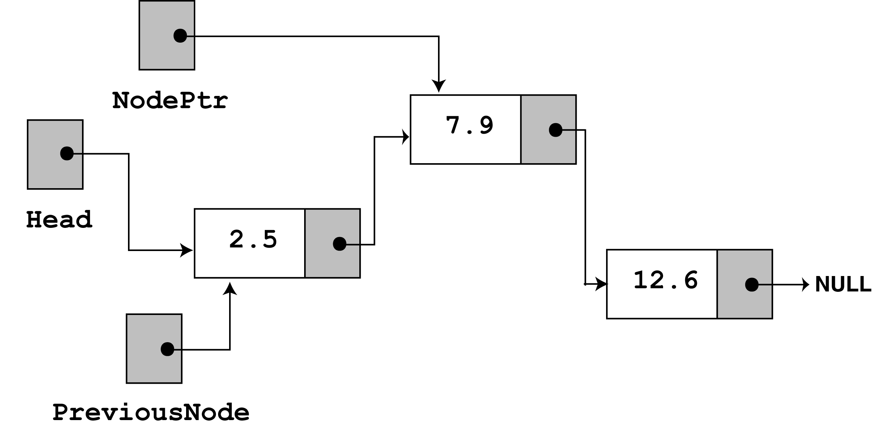
Look at the else part of the second if statement. This is where the function will perform its action since the list is not empty, and the first node does not contain the value 7.9. Just like insertNode, this function uses nodePtr and previousNode to traverse the list. The while loop terminates when the value 7.9 is located. At this point, the list and the other pointers will be in the state depicted in the figure below.
www.hndit.com

Slide 48
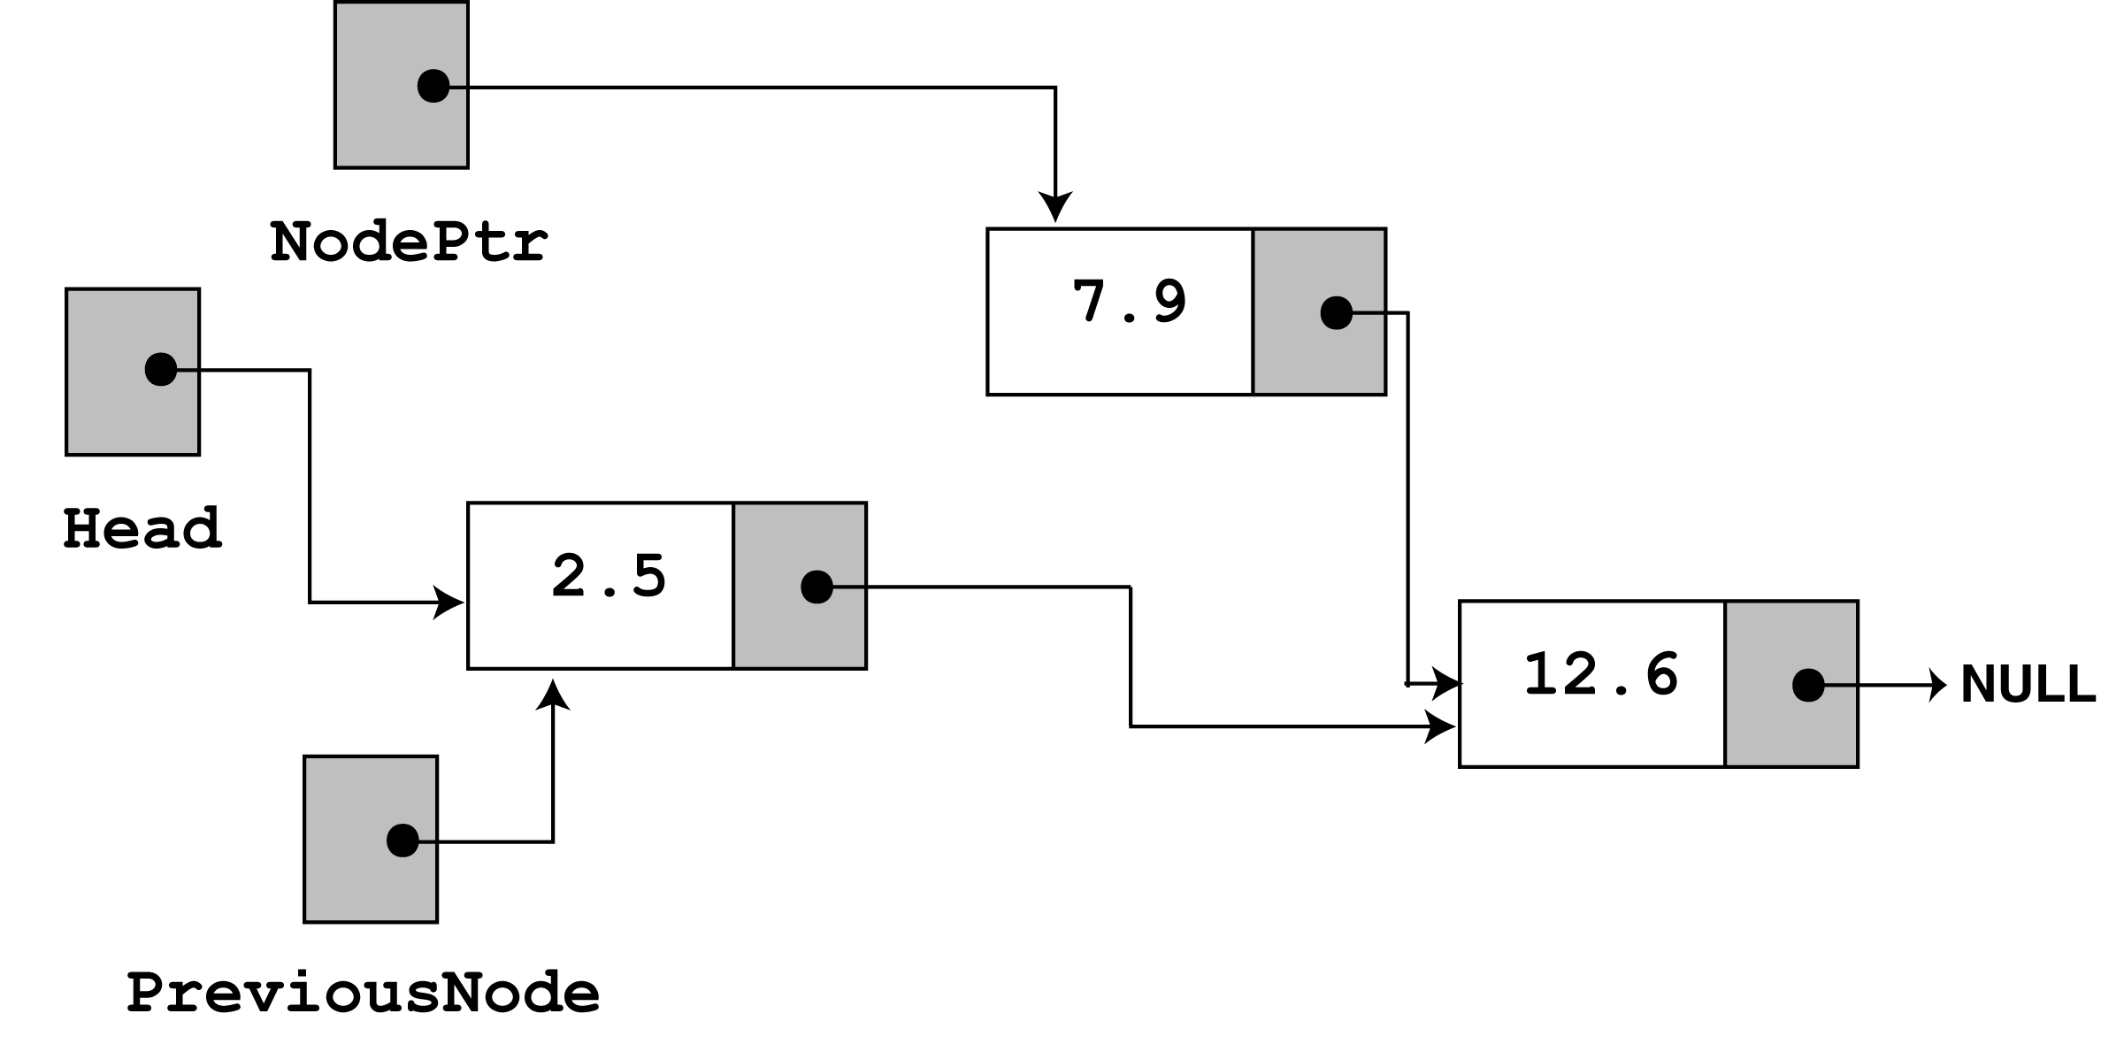
next, the following statement executes.
previousNode->next = nodePtr->next;
The statement above causes the links in the list to bypass the node that nodePtr points to. Although the node still exists in memory, this removes it from the list.
www.hndit.com
The last statement uses the delete operator to complete the total deletion of the node.

Slide 49
Destroying the List
www.hndit.com
The class's destructor should release all the memory used by the list.
It does so by stepping through the list, deleting each node one-by-one. The code is shown on the next slide.

Slide 50
FloatList::~FloatList(void)
{
ListNode *nodePtr, *nextNode;
nodePtr = head;
while (nodePtr != NULL)
{
nextNode = nodePtr->next;
delete nodePtr;
nodePtr = nextNode;
}
}
www.hndit.com
Notice the use of nextNode instead of previousNode. The nextNode pointer is used to hold the position of the next node in the list, so it will be available after the node pointed to by nodePtr is deleted.

Slide 51
List features
www.hndit.com
maintains ordering in order elements were added
(new elements are added to the end by default)
duplicates and null elements allowed
list manages its own size; user of the list does not need to worry about overfilling it
operations:
          Add element to end of list
          Insert element at given index
          Clear all elements
          Search for element
          Get element at given index
          Remove element at given index
          Get size

Slide 52
Double-Ended Lists
www.hndit.com
Similar to an ordinary list with the addition that a link to the last item is maintained along with that to the first.
The reference to the last link permits to insert a new link directly at the end of the list as well as at the beginning.
This could not be done in the ordinary linked list without traversing the whole list.
This technique is useful in implementing the Queue where insertions are made at end and deletions from the front.

Slide 53
Linked List Efficiency
www.hndit.com
Insertion and deletion at the beginning of the list are very fast, O(1).
Finding, deleting or inserting in the list requires searching through half the items in the list on an average, requiring O(n) comparisons.
Although arrays require same number of comparisons, the advantage lies in the fact that no items need to be moved after insertion or deletion.
As opposed to fixed size of arrays, linked lists use exactly as much memory as is needed and can expand.

Slide 54
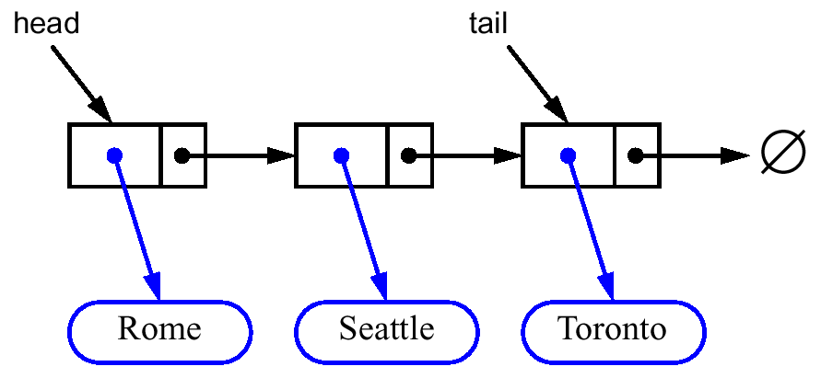
Singly Linked List
www.hndit.com
Nodes (data, pointer) connected in a chain by links
the head or the tail of the list could serve as the top of the stack

Slide 55
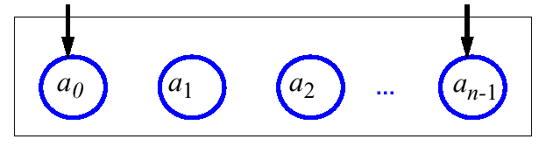
Queues
www.hndit.com
A queue differs from a stack in that its insertion and removal routines follows the first-in-first-out (FIFO) principle.
Elements may be inserted at any time, but only the element which has been in the queue the longest may be removed.
Elements are inserted at the rear (enqueued) and removed from the front (dequeued)
Front
Rear
Queue

Slide 56
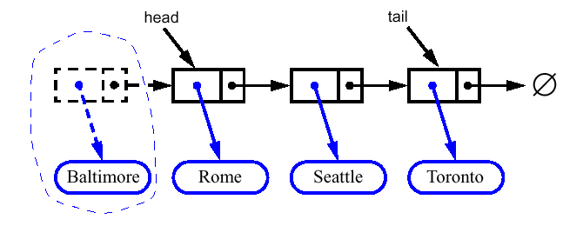
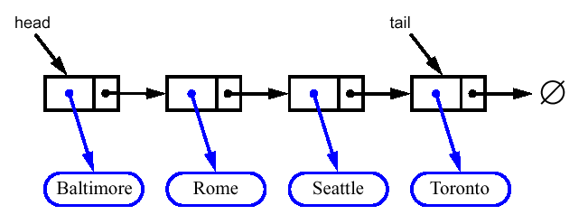
Linked List Implementation
www.hndit.com
Dequeue - advance head reference

Slide 57
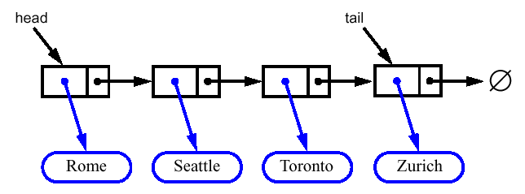
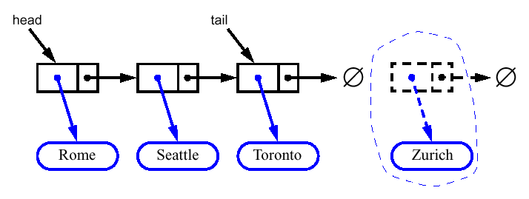
Linked List Implementation
www.hndit.com
Enqueue - create a new node at the tail
chain it and move the tail reference

Slide 58
QUEUES USING LINKED LISTS
www.hndit.com
#include <iostream>
using namespace std;
struct node
{
int data;
node *link;
};
class lqueue
{
private:
node *front,*rear;
public:
lqueue()
{
front=NULL;
rear=NULL;
}
void add(int n)
{
node *tmp;
tmp=new node;
if(tmp==NULL)
cout<<"\nQUEUE FULL";
tmp->data=n;
tmp->link=NULL;
if(front==NULL)
{
rear=front=tmp;
return;
}
rear->link=tmp;
rear=rear->link;
}

Slide 59
int del()
{
if(front==NULL)
{
cout<<"\nQUEUE EMPTY";
return NULL;
}
node *tmp;
int n;
n=front->data;
tmp=front;
front=front->link;
delete tmp;
return n;
}
www.hndit.com
~lqueue()
{
if(front==NULL)
return;
node *tmp;
while(front!=NULL)
{
tmp=front;
front=front->link;
delete tmp;
}
}
};

Slide 60
int main()
{
lqueue q;
q.add(11);
q.add(22);
q.add(33);
q.add(44);
q.add(55);
cout<<"\nItem Deleted = "<<q.del();
cout<<"\nItem Deleted = "<<q.del();
cout<<"\nItem Deleted = "<<q.del();
return 0;
}
www.hndit.com

Slide 61
STACKS USING LINKED LISTS
www.hndit.com
#include <iostream>
using namespace std;
struct node
{
int data;
node *link;
};
class lstack
{
private:
node* top;
public:
lstack()
{
top=NULL;
}
void push(int n)
{
node *tmp;
tmp=new node;
if(tmp==NULL)
cout<<"\nSTACK FULL";
tmp->data=n;
tmp->link=top;
top=tmp;
}

Slide 62
int pop()
{
if(top==NULL)
{
cout<<"\nSTACK EMPTY";
return NULL;
}
node *tmp;
int n;
tmp=top;
n=tmp->data;
top=top->link;
delete tmp;
return n;
}
www.hndit.com
~lstack()
{
if(top==NULL)
return;
node *tmp;
while(top!=NULL)
{
tmp=top;
top=top->link;
delete tmp;
}
}
};

Slide 63
int main()
{
lstack s;
s.push(11);
s.push(101);
s.push(99);
s.push(78);
cout<<"Item Popped = "<<s.pop()<<endl;
cout<<"Item Popped = "<<s.pop()<<endl;
cout<<"Item Popped = "<<s.pop()<<endl;
return 0;
}
www.hndit.com

Slide 64
Double-Ended Queue
www.hndit.com
A double-ended queue, or deque, supports insertion and deletion from the front and back
The deque supports six fundamental methods
  InsertFirst :ADT - Inserts e at the beginning of deque
  InsertLast :ADT - Inserts e at end of deque
  RemoveFirst :ADT – Removes the first element
  RemoveLast :ADT – Removes the last element
  First :element and Last :element – Returns the first and the last elements

Slide 65
Stacks with Deques
www.hndit.com
Implementing ADTs using implementations of other ADTs as building blocks
Stack Method | Deque Implementation
size() | size()
isEmpty() | isEmpty()
top() | last()
push(o) | insertLast(o)
pop() | removeLast()

Slide 66
Queues with Deques
www.hndit.com
Queue Method | Deque Implementation
size() | size()
isEmpty() | isEmpty()
front() | first()
enqueue(o) | insertLast(o)
dequeue() | removeFirst()

Slide 67
Doubly Linked Lists
www.hndit.com
Doubly-linked list nodes contain two references that point to the next and previous node.
Such a list has a reference, front, that points to the first node in the sequence and a reference, back, that points at the last node in the sequence.

Slide 68

Doubly Linked Lists (continued)
www.hndit.com
You can scan a doubly-linked list in both directions. The forward scan starts at front and ends when the link is a reference to back. In the backward direction simply reverse the process and the references.

Slide 69
Doubly Linked Lists (continued)
www.hndit.com
Like a singly-linked list, a doubly-linked list is a sequential structure.
To move forward or backward in a doubly‑linked list use the node links next and prev.
Insert and delete operations need to have only the reference to the node in question.

Slide 70
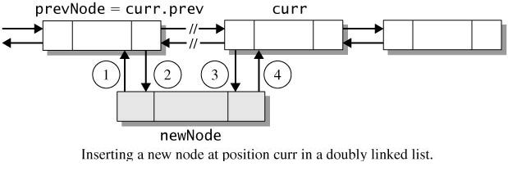
Doubly Linked Lists (continued)
www.hndit.com
Inserting into a doubly linked list requires four reference assignments.
prevNode = curr.prev;
newNode.prev = prevNode; // statement 1
prevNode.next = newNode; // statement 2
curr.prev = newNode; // statement 3
newNode.next = curr; // statement 4

Slide 71
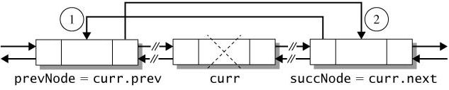
Doubly Linked Lists (continued)
www.hndit.com
To delete a node curr, link the predecessor (curr.prev) of curr to the successor of curr (curr.next).
prevNode = curr.prev;
succNode = curr.next;
succNode.prev = prevNode; // statement 1
prevNode.next = succNode; // statement 2

Slide 72
Doubly Linked Lists (continued)
www.hndit.com
In a singly-linked list, adding and removing a node at the front of the list are O(1) operation.
With a doubly-linked list, you can add and remove a node at the back of the list with same runtime efficiency. Simply update the reference back.

Slide 73
Doubly Linked Lists
www.hndit.com
Solves the problem of traversing backwards in an ordinary linked list.
A link to the previous item as well as to the next item is maintained.
The only disadvantage is that every time an item is inserted or deleted, two links have to be changed instead of one.
A doubly-linked list can also be created as a double – ended list.

